Slide 1
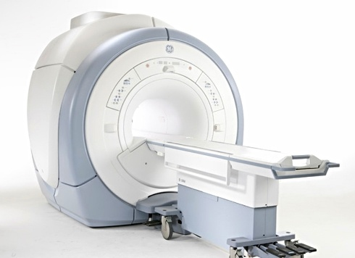
GE MRI SIGNA EXCITE HDxt

Slide 2
Objectives:
Understand the components and differences of the Excite platform
Overview of the different subsystems
To gain some basic troubleshooting skills and understand most common problems

Slide 3
Excite Platform Changes
The Signa family gets a huge redesign
First systems start as 10x with an Octanes II but a promise is made to upgrade to HP computers when they are ready.
Since there are a few kinks to work out and computers were replaced, system moves to 11x and we cannot find 10x systems nowadays.
System starts using HP workstations and Red Hat Linux software
8CH coil is introduced
Only ACGD gradient compatible. If you upgrade to excite from an older gradient cabinet it needs to be upgraded.
Diagnostics and calibrations start getting attention and they improve.
It keeps most of the hardware components from the LX and is mostly the electronics that change.
11x Up to 8 channel coils.
12x introduces possibility for 16ch coils
14x and above capable of 32 channels but only a couple of those were ever built.
32 channels started with the Discovery family (room for improvement up to 128 channels)

Slide 4
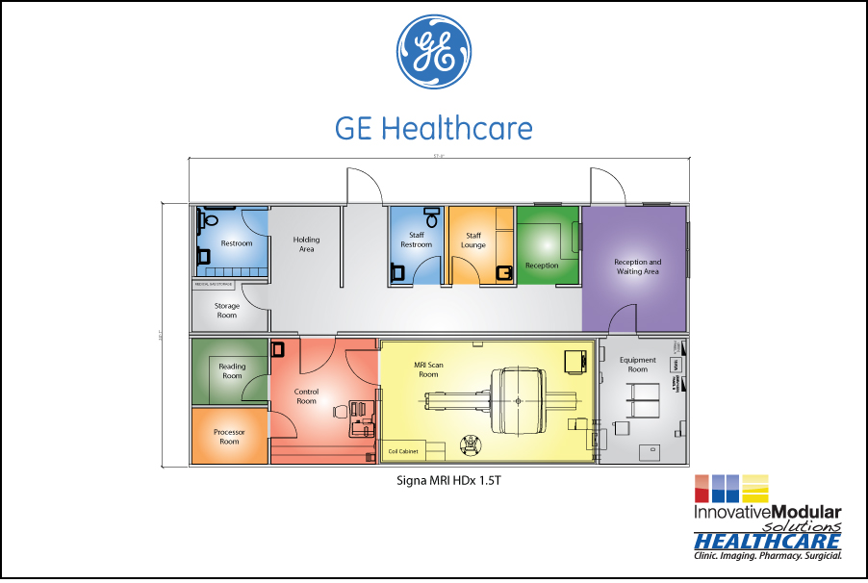
Typical Room Layout
System
Cabinet
Phantom cart
Magnet
MRU
RF Cabinet
Rear Pedestal
MDCP
Patient Table
Coldtrac
MM3
Patient Blower
Gradient
Cabinet / PDU
Console
SRI PAC
(On tray under magnet)
Compressor
Penetration
Panel
Gradient Chiller

Slide 5
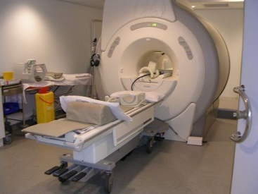
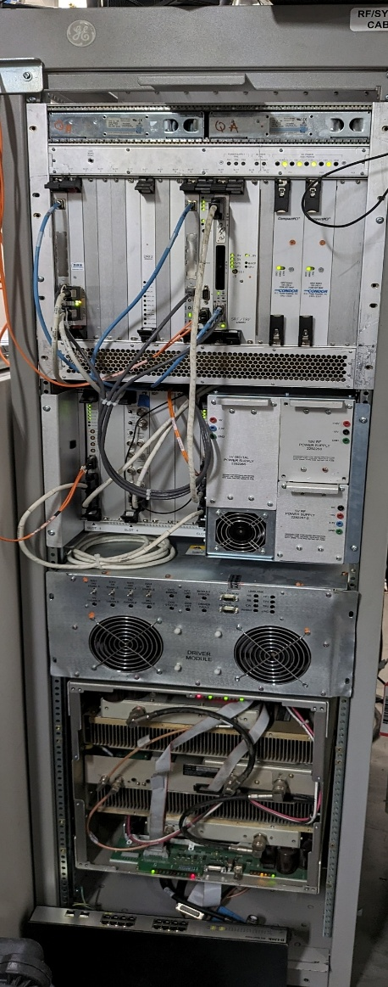
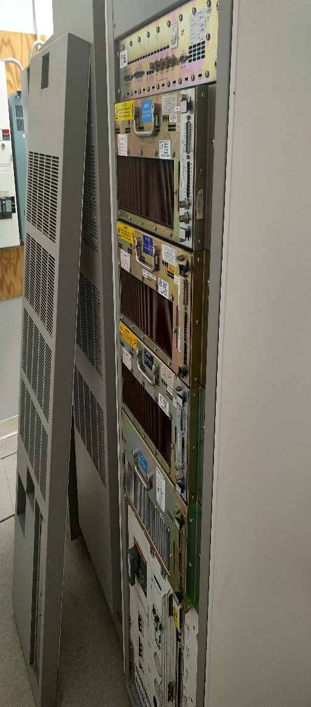
System Picture

Slide 6
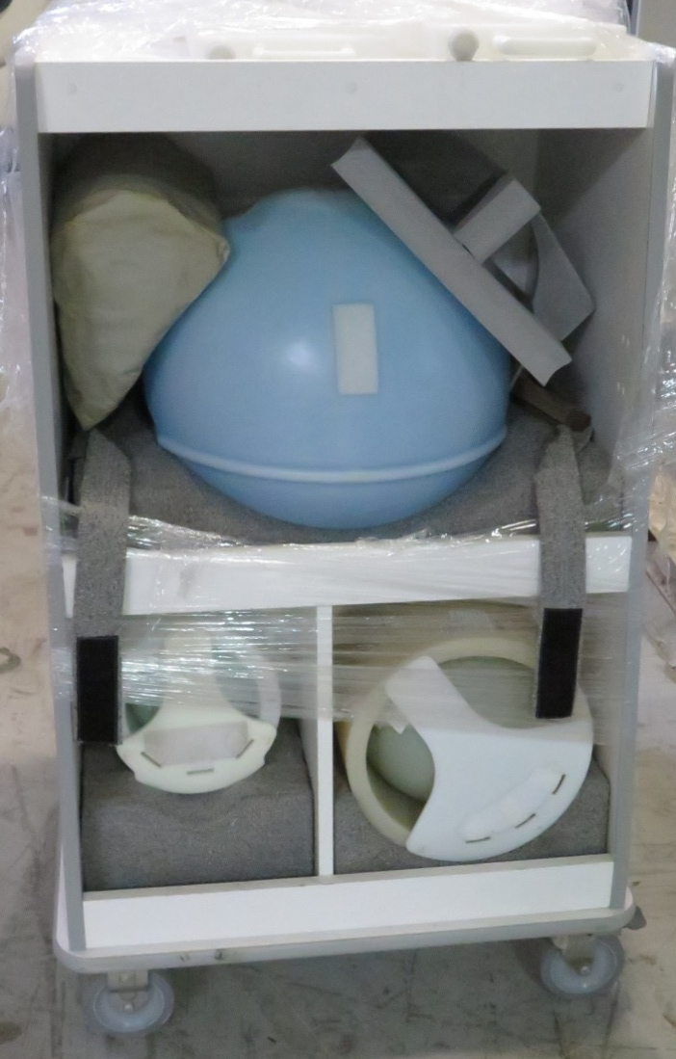
Phantom Cart
CART
Other items:
- EPT Phantoms
- Grafidy plate
- Other Phantoms
Lvhim
Phantom
- Head Loader
- DQA phantom
Body Loader

Slide 7
RF Subsystem
Receives the pulse information from the Exciter and produces the output RF transmission signal that will travel to the pertinent coil.
Only two outputs out of the amplifier: head or body.
In a 1.5T should have 16kw for body and 2kw for head
SRF2

Slide 8
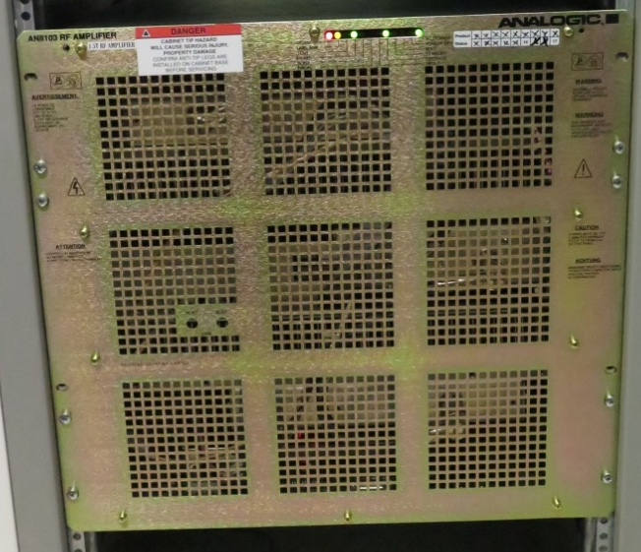
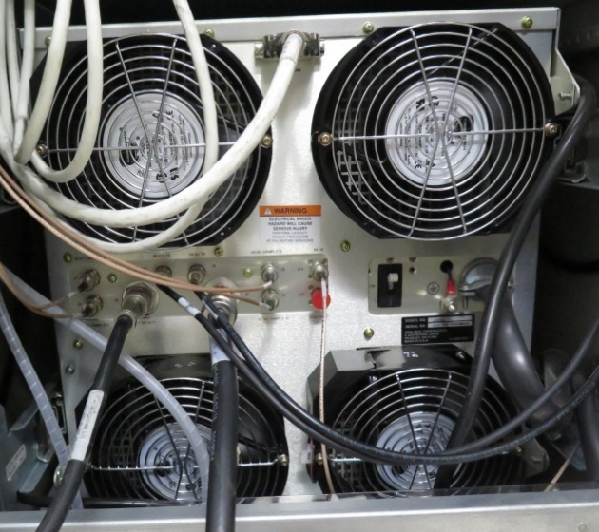
SRFD2 (Scalable RF Driver 2)
Solid state RF amplifier Analogic 8103
Only head and body gain adjustment
Has a breaker on the back
Most reliable
Harder to troubleshoot since there are not parts that can be swapped, need RF kit to trouble shoot
Error logs tend to be correct

Slide 9
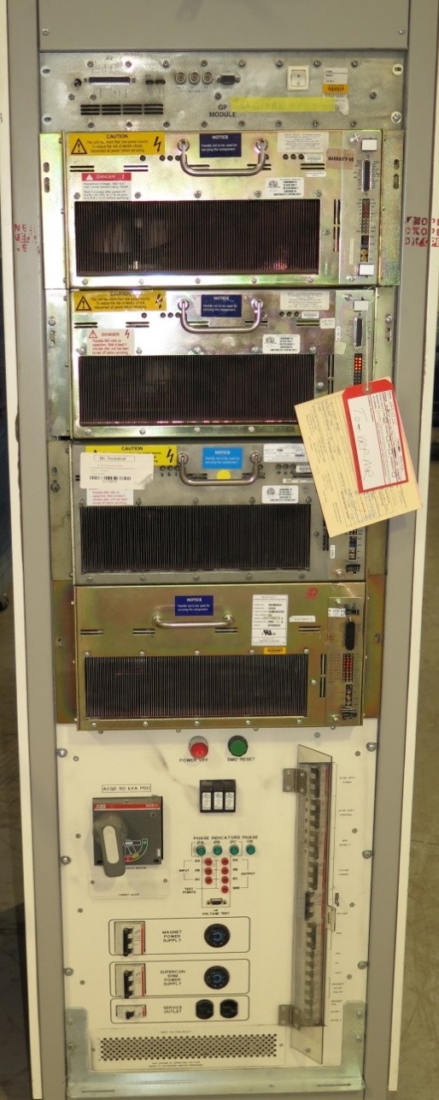
ACGD (Advance Control Gradient Driver)
Cabinet Fan
ACGD Combines the functionality of the SGD in each module
Much more reliable and powerful
Gradient coil problems since they were not designed to handle that much power, especially as you start getting into the higher Excite platform systems with HFD-S gradients.
The GP module controls all the commands to the 3 axis and the PS. There are three GP versions: GP, GPII and GP3.
There are three SGA (Switching Gradient Amplifier), one for each axis. They have a control board. This control board is swappable and replaceable.
GP
SGA X axis
SGA Y axis
Control
SGA Z axis
SGA PS
3φ 480 VAC*
208 VAC
Note: Also 200,208,380 or 415 VAC compatible configurable at the PDU

Slide 10
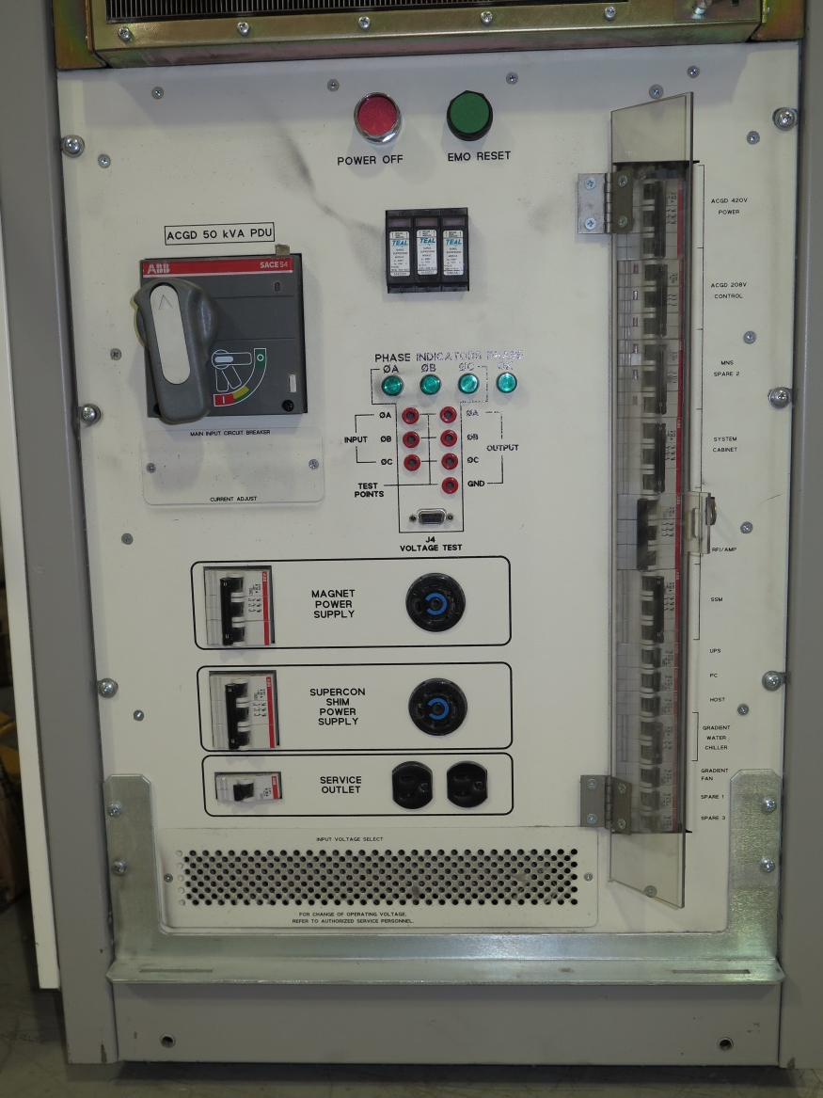
TEAL PDU
Configurable through jumpers behind the plate in the lower part of the unit.
Quarter turn handle restores power to it
Subsystem breakers to turn power off to individual subsystems only.
It has three TVSS (fuse) that can go bad if a surge is experienced.
Very typical to have a phase crossed during installations, the LEDs for the phase would detect that they are there but not tell you if it is correct. If phases are swapped you cannot complete EMO reset and gradient cabinet fan would turn in the opposite direction.
In some instances the 24V PS can stop working and that would stop the system from being able to reset the EMO. This supply and the TVSS are the only replaceable parts in this PDU.
Refer to vendor manual in Service Methods CD.

Slide 11
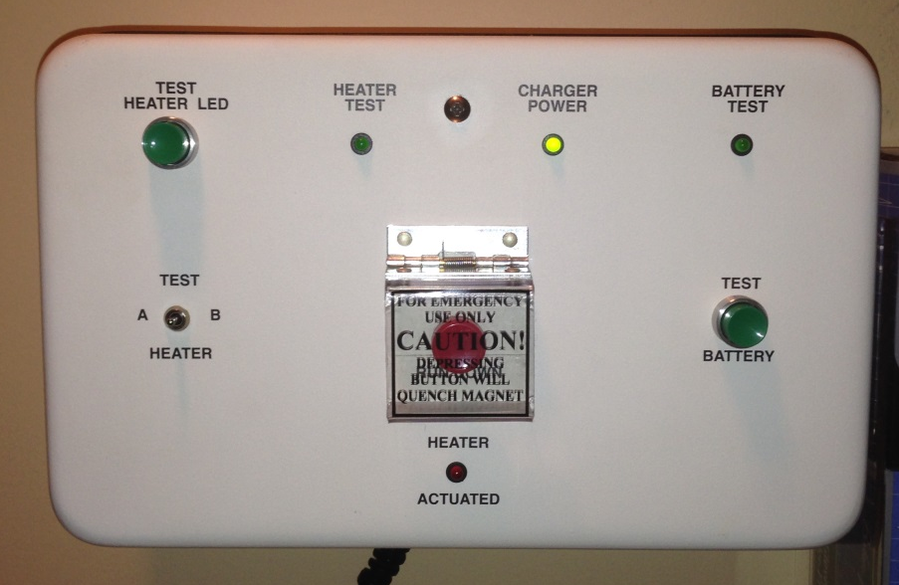
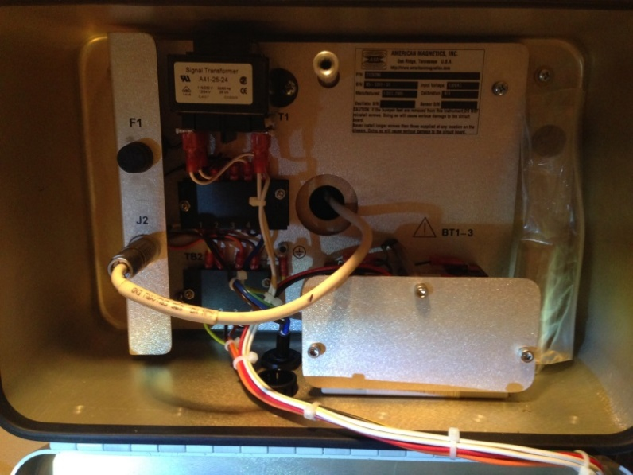
MRU or ERU
Magnet Rundown Unit or Emergency Rundown Unit.
Red button on the center initiates the quench.
You have to intentionally lift the cover and push it.
A current is sent to the heater inside the magnet that creates heat and disturbs the stable magnet environment and initiates the quench.
During PMs all test have to be performed:
Push and hold a few seconds the battery test. If it doesn’t stay on, new batteries are required.
Hold the Test Heater LED button, the Heater Test LED should light up
Flip the Test Heater switch to each side to make sure both heaters are connected and the Heater Test LED lights up when pushed.
If you find any deficiencies, please escalate to your GE MR Specialist.
When servicing the MRU always disconnect J2 and give it three minutes after the quench button has been pressed before reconnecting it.

Slide 12
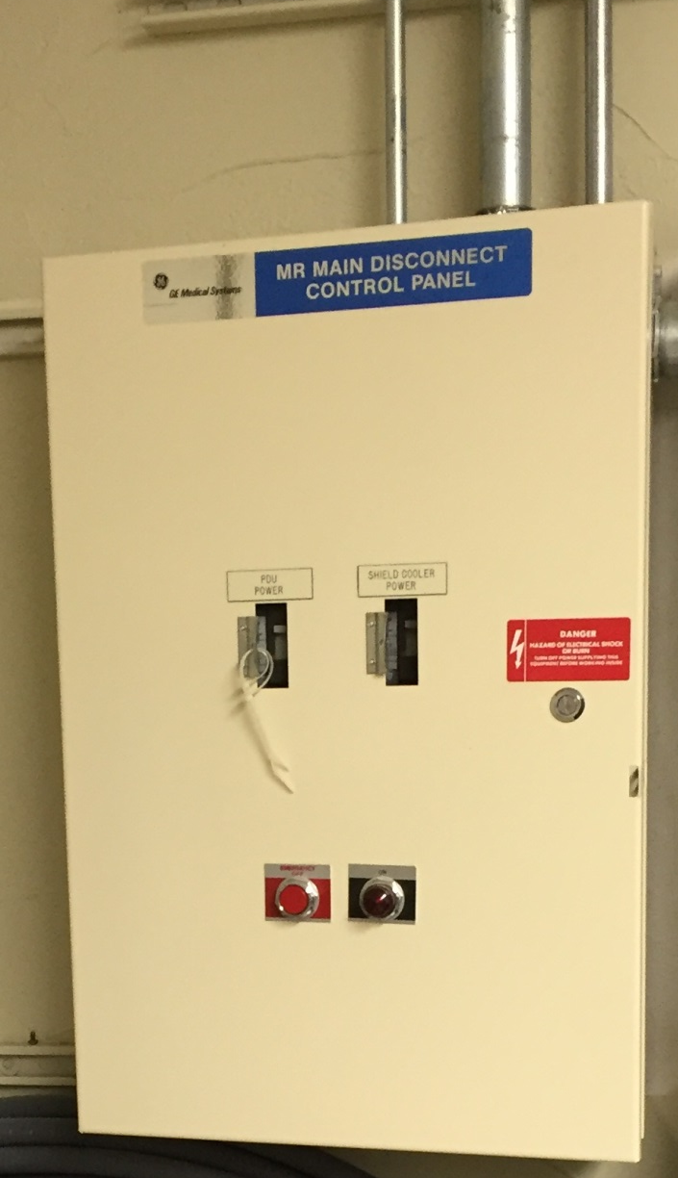
Main Disconnect Control Panel (MDCP)
Hospital electrical connection.
It is the hospital responsibility and sometimes a custom panel is made by the customer.
Needs to have separate breaker for the PDU and the Cryo cooler compressor.

Slide 13
System Cabinet – Contents
Rev. 1
MGD Chassis – Multi-Generational Data acquisition chassis – consists of components that generate the timed control signals necessary to control the MR imaging system under the direction of the imaging sequence. (pulse sequence) These control signals drive the gradient output, rf output, as well as gate the rf receive window. Details of the circuit board functionality is described later.
ASC Chassis – Amplifier Support Controller – provides the Narrow and Broadband RF Amplifier interface (Control signals) and RF Power Monitoring. See the ASC help pages for more details.
CAM Chassis – Combined ASC and MGD Chassis – combines the MGD and ASC functionality into one chassis. See the MGD Chassis or ASC Chassis for the detailed board functionality. The CAM chassis differences to the MGD chassis are described in this help document.
Term Server – permits RS-232C serial connection to each of the processor boards (APS, AGP, SCP) and the STIF Board by utilizing the existing Ethernet link.
VRE – Volume Reconstruction Engine – which reconstructs the image. The VRE is made up of the Infiniband board contained within the MGD or CAM chassis, the Image Compute Nodes (ICNs), and the Network Switch. Some early 4 ICN systems also included an Infiniband Switch. The Infiniband Switch is not necessary anymore and can be removed by rewiring the system.
Network Switch – 16 to 24 port Gigabit Ethernet switch that provides a network path between the Host computer and the ICNs, MGD processors, and the Term Server. This network path is used for application download to the controllers, including the downloading of PSDs to the MGD. It is also used for serial communication between the host and the three (3) MGD processor boards and the STIF board.
ICNs – Image Compute Nodes – Rack mounted computers that provide the high speed image data to the Host computer.

Slide 14
Upgrades vs Forward production
Systems are design to be able to keep some of the older electronics if the technology can be adapted to the newer revisions to keep upgrade costs down.
You can find various combinations and mismatches of the technology covered in this class.
Please refer to your system and the Parts manual to be able to pinpoint the system you are working on or the part needed.

Slide 15
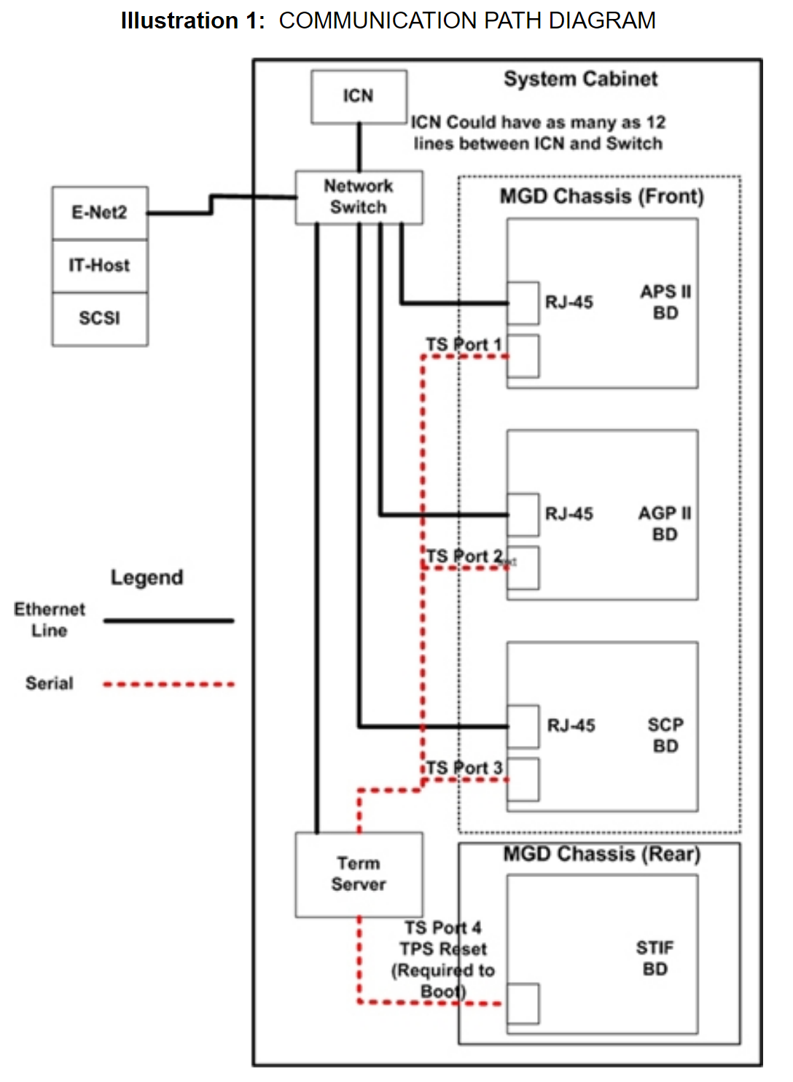
Communication Paths

Slide 16
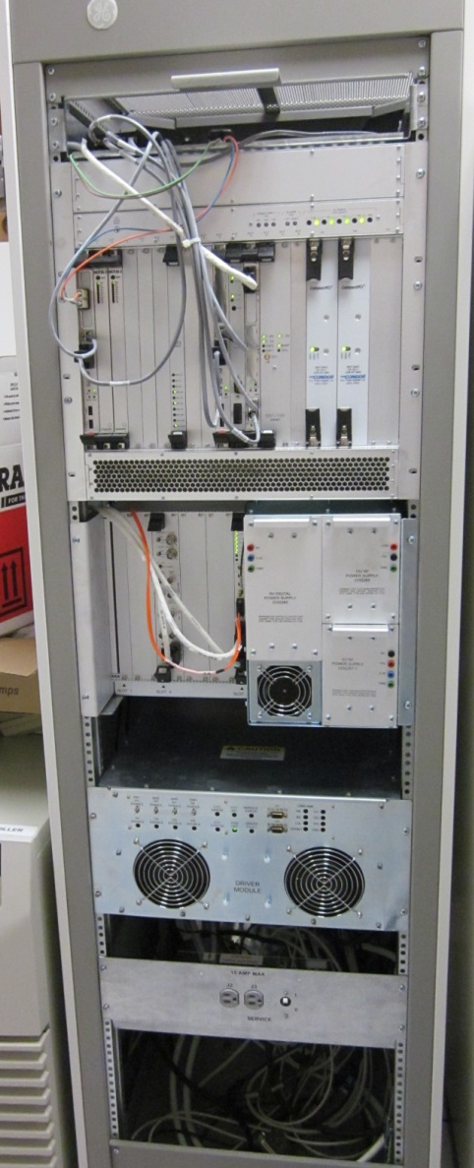
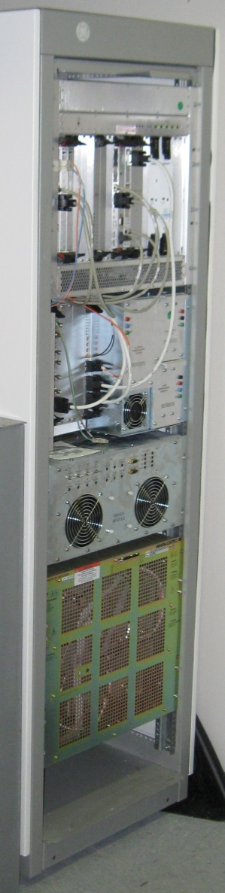

Systems Cabinet
Probably the biggest changes in the system happen in the console and the system cabinet.

Slide 17
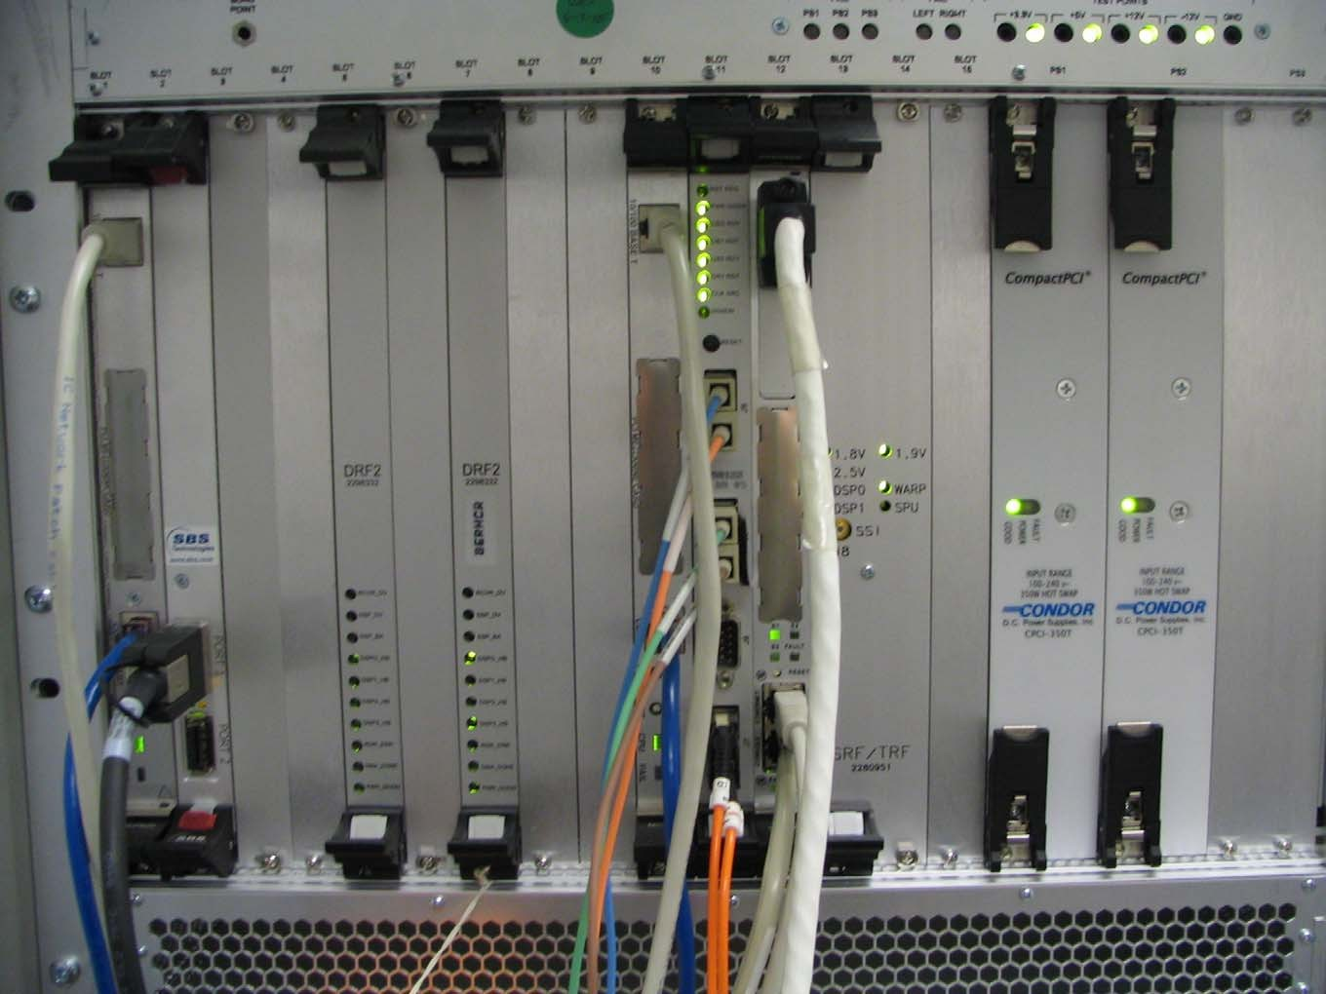
System Cabinet – MGD Chassis (Front view)
Rev. 1
All the circuit boards that comprise the MGD are contained in the Multi-Generational Data acquisition Chassis. Boards are located on the front and the rear of the chassis and all the boards interface to a common mid-plane. The mid-plane contains two independent compact-PCI buses that are linked together by the Bridge Board. The compact-PCI bus standard is connectors with male pins present on the mid-plane. Exercise care when replacing or installing circuit boards in the MGD Chassis in order to avoid bending one of these pins. Before installing or replacing a board into an empty slot, visually inspect the connectors on the mid-plane for bent pins.
Also,check the female connector on the board for signs of damage before attempting to seat the board into the slot. All the slots are keyed in order to make it difficult to put the wrong board into the wrong slot. Two fans are located behind the metal cover plate at the top-front of the MGD Chassis. The MGD Chassis contains two independent temperature sensors. One is designed to report an over-temp condition when the temperature in the chassis reaches 40 degrees C (104 degrees F) while the other will report an over-temp condition when the temperature in the chassis reaches 50 degrees C (122 degrees F).
The minimum configuration of boards installed in the MGD Chassis necessary for applications to successfully load are as follows: APS Board, AGP Board, SCP Board, PS1 and PS2 power supplies, and Bridge Board. All these boards must be installed in the correct slots with all the necessary cabling attached. As long as one is confident that the software is in good working order, failure of the applications software to boot successfully at this point may indicate that one of these boards has failed. Use “cu” (serial connection) or “rlogin” (Ethernet) to login to each the boards and monitor them for suspicious failures during the next boot.
Note the gray tabs inset into the black tabs on the DRF2 Boards, IRF2 Board, SRF/TRF Board, IRF I/O Board (not shown), and STIF Board (not shown). In order to remove these boards, the two screws that secure the boards to the MGD Chassis must be retracted and the gray tabs inset in each of the upper and lower black tabs must be pressed inward to allow the black tabs to release. This must be done before attempting to use the tabs to extract the boards. Failure to release the black tabs first will result in physical damage to the black tabs.

Slide 18
System Cabinet – MGD Chassis Front
Rev. 1
Acquisition Processing Subsystem (APS) Board (Slot 1 F)
This board is responsible for coordinating the data acquisition and reconstruction process. The top cable, equipped with the male RJ-45 connector, provides an Ethernet link between the Host and the APS. During a TPS Reset data is transferred to the APS via this link. This link is also used during the transfer of raw image data. The bottom cable, equipped with the male RJ-45 connector, provides a service RS-232 serial link between the APS and the Host via the Term Server. The APS Board is identical and interchangeable with the AGP Board. There are no other changes or jumper settings that must be made when swapping the APS and AGP Boards.
Available Diagnostics for Testing the APS
MGD Datapaths: APS -> Bridge, IRF -> APS, SRF -> APS
APS, AGP and SCP Board Level Diagnostics: APS
Host Datapath Diagnostics: Host Ping -> APS

Slide 19
System Cabinet – MGD Chassis Front
Rev. 1
Infiniband Board (Slot) 2F
The Infiniband board is the high speed communication link between the MGD chassis and the VRE (Volume Reconstruction Engine). The Infiniband board transports acquired data frames output from the DRF2 to the input buffers on the VRE. The VRE does image reconstruction.
Available Diagnostics for Testing the Infiniband board
Infiniband Communications Diagnostic
Infiniband Board Loopback Test

Slide 20
Digital Receive Filter DRF2 board
Rev. 1
The DRF2 Board supports 16 receive channels, each at +/- 250KHz bandwidth. Each MGD Chassis contains at least one of these boards. The data handled by this board is digital and not analog. This board provides digital filtering for the digitized data received via the IRF2 from the receiver boards in the RRF chassis. After a successful TPS Reset the LEDs on the front of the DRF2 Board should flash in a vertical sequence.
Available Diagnostics for Testing the DRF2 Board
MGD Board Level Diagnostics: DRF BLD
MGD Datapaths: IRF -> DRF, SRF -> DRF

Slide 21
System Cabinet – MGD Chassis Front
Rev. 1
Application Gateway Processor (AGP) Board (Slot 10 F)
This board coordinates the work of the IRF, IRF I/O, SRF/TRF, and STIF Boards to create the digital RF and gradient data needed to generate the scan waveforms.
The top cable, equipped with the male RJ-45 connector, provides an Ethernet link between the Host and the AGP. During a TPS Reset data is transferred to the AGP via this link. The bottom cable, equipped with the male RJ- 45 connector, provides a service RS-232 serial link
between the AGP and the Host via the Term Server. The AGP Board is identical and interchangeable with the APS Board. There are no other changes or jumper settings that must be made when swapping the AGP and APS Boards.
Available Diagnostics for Testing the AGP Board
MGD Datapaths: AGP -> Bridge
APS, AGP and SCP Board Level Diagnostics: AGP
Host Datapaths: Ping -> AGP

Slide 22
System Cabinet – MGD Chassis Front
Rev. 1
Interface & Remote Functions (IRF-2) Board (Slot 11 F)
The IRF2 provides a master data acquisition clock signal to the rest of the MGD components. This signal is obtained from a 20MHz reference provided by the RRF Master Exciter. The IRF Board transfers digitized data from the SRF/TRF Board to the Exciter(s) in the RRF so that the RF waveforms can be generated. The IRF2 Board receives view data from the receivers that it sends to the DRF2(s).
The IRF Board also provides for control and status monitoring of coil temperature, PDU mode, scan room door status, bore fan, bore lights, and alignment lights. The RESET button on the front of this board can be used to
initiate a manual reset of the MGD if the serial reset line is not working. Press this button and then either TPS Reset or boot applications. Timing is critical so if it does not work the first time, try again.
The IRF-2 board is needed for HDx as the interface to the single DRF-2 board as it enables the interface for 16 channel option. Software will not support the IRF-1 board in 14x.
Available Diagnostics for Testing the IRF Board
MGD Board Level Diagnostics: IRF BLD
MGD Datapaths: IRF -> DRF, IRF -> IRF I/O, IRF -> APS, SRF -> IRF

Slide 23
System Cabinet – MGD Chassis Front
Rev. 1
Scan Control Processor (SCP) Board (Slot 12 F)
This board is responsible for providing scan state information to the APS and AGP. It also controls the peripheral hardware, scan time and display, and control of the physiological interface. A Controller Area Network (CAN) Daughter-Board (slot 12A F) is mounted in the top of the SCP Board through which communication is managed between the SCP and the gradient controller, power monitor, PHPS, Shim Supply, RRF and Driver Module. The middle cable, equipped with the male RJ-45 connector, provides an Ethernet link between the Host and the SCP. During a TPS Reset data is transferred to the SCP via this link. The bottom cable, equipped with an RJ-45 connector, provides a service
RS-232 serial link between the SCP and the Host via the
Term Server.
Available Diagnostics for Testing the SCP
APS, AGP and SCP Board Level Diagnostics: SCP
SRI Datapaths: SRI SCP Loop Test, SRI STIF Loop Test
MGD Datapaths: SCP -> CAN
Host Datapath Diagnostics: Ping -> SCP

Slide 24
System Cabinet – MGD Chassis Front
Rev. 1
Sequence Related Functions / Trigger & Rotational Functions (SRF/TRF) Board (Slots 13,14 F)
This two-board assembly generates the digital data needed for producing the RF and gradient waveforms necessary for scanning. It also provides these functions:
•Oblique Plane Imaging rotation algorithm (WARP/TRF)
•Real-time B0 eddy current compensation (WARP/TRF)
•Scan sequence control (SRF)
•Physiological gating algorithms (SPU/TRF)
•Physiological waveform display generation (SPU/TRF)
The functions of Signal Processing Unit for physiological gating (SPU) and WAveform and Rotation Processor (WARP), as listed above, are done on this board. This board communicates with the PAC and gradients via high- speed serial interfaces.
After a successful TPS Reset the DSP0, DSP1, and WARP LEDS should be flashing.
Available Diagnostics for Testing the SRF/TRF
MGD Board Level Diagnostics: TRF BLD, SRF BLD
MGD Datapaths: SRF -> DRF, SRF -> IRF, SRF -> TRF, SRF -> APS

Slide 25
System Cabinet – MGD Chassis Front
Rev. 1
Power Supply Modules (PS1 F, PS2 F)
Both modules work in tandem to supply power to the MGD Chassis. The output voltages these boards provide cannot be adjusted. During normal operation the green POWER SUPPLY LED will be illuminated. Some types of power supply failures will cause the red FAULT LED to illuminate. A row of Green indicator LEDs located above the supplies in the MGD Chassis provide a visual indication of each supply voltage. Test points next to each LED provide a convenient measurement location for checking the condition of each supply voltage with a Digital Multimeter. Please note that the MGD hardware does NOT support “hot swapping” (i.e. removing and installing power supply with power on) of power supplies. In the event that one of the modules fails, it is recommended to not operate the MGD Chassis with a single supply. One reason for not doing this is that the air flow will be compromised due to the missing supply. This forces the other boards to operate at less than optimal temperatures which could cause damage. Another reason for not doing this is that the remaining power supply is operating over capacity to supply all the MGD Chassis power needs. This can damage the power supply and introduce intermittent failures that may be difficult to isolate. The more options (boards) installed the more stress and possible damage a single supply may encounter.

Slide 26
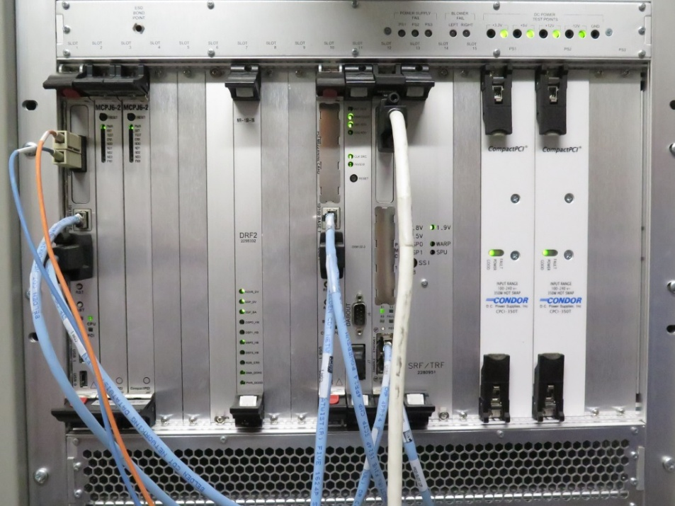
MGD Troubleshooting
The minimum configuration needed to boot up the MGD chassis is:
SCP
APS
AGP
Bridge board
Power Supplies
With this configuration, application will be able to boot all the way up but TPS will not respond. Very useful for down systems.
We can ping all three processor boards from the host, that tells us that they are alive and the network path is working.
We can ping the term server
Measure power supply for term server, fails with power outages.
Swap AGP and APS.
Ping the network card (tgate)
Ping the term server (TS1)
Change the term server legs and do a TPS reset.
You can watch the processors boot by typing ‘mgd_term’ in a cshell.
Load software when ordering parts. In many instances, application software corruption will have the same symptoms as the board failures.

Slide 27
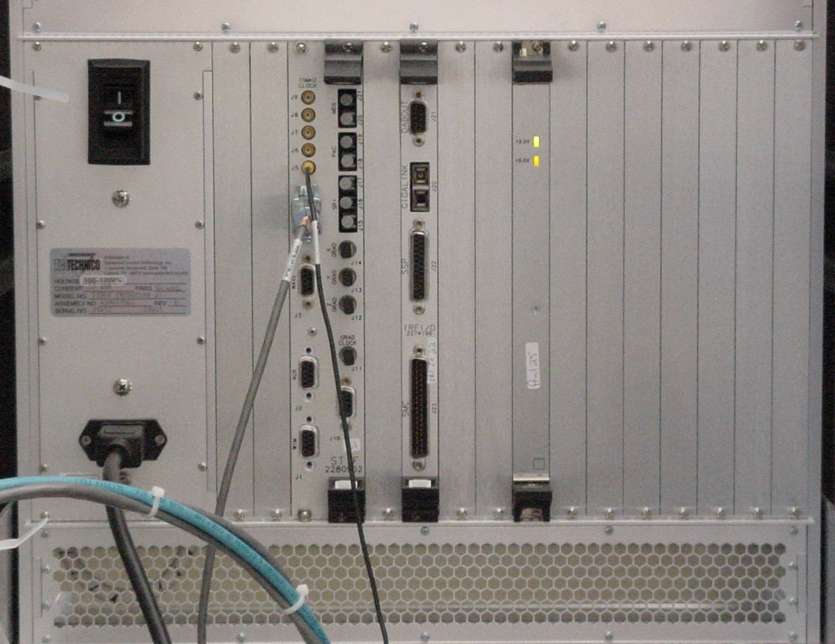
System Cabinet – MGD Chassis Rear
Rev. 1
This board provides a communication bridge between the AGP and APS sides of the two PCI buses. The two LEDs on the rear of the board provide a visual indication of the status of the bus power supplies.
Bridge Board (Slot 8 R)
Available Diagnostics for Testing the Bridge Board
MGD Host Datapaths: These tests indirectly test the functionality of the Bridge by checking the identity of the APS and AGP Boards. These boards will assume default identities if the boards cannot communicate because the Bridge Board has failed. The assumption of default identities by the APS and AGP Boards does not always indicate that the Bridge Board has failed. It only indicates that during the initialization period the AGP and APS boards could not, for some reason, communicate.
MGD Datapaths: APS -> Bridge, AGP -> Bridge

Slide 28

System Cabinet – MGD Chassis Rear
Rev. 1
Interface & Remote Functions Input/Output (IRF I/O) Board (Slot 11 R)
This board is a communications interface between the IRF2 Board and RRF Module, and IRF2 Board and system control and status functions. The fiber optic cable interfaces to the “Gigalink” port on the rear of the board and connects to the right most RF- DIF Board in the RRF Module (for 16 channel systems). This board also provides a System Monitor and Control (SMC) interface by which the IRF2 Board can monitor the PDU mode, Gradient Coil Temperature, Scan Room Door status, and E- Stop signal and control the Alignment Lights, Bore Lights, and Bore Fan.
Available Diagnostics for Testing the IRF I/O Board
MGD Datapaths: IRF -> IRF I/O
RRF Datapaths: RRF Loopback

Slide 29
System Cabinet – MGD Chassis Rear
Rev. 1
SRF / TRF InterFace (STIF) Board (Slots 13,14 R)
This board provides the fiber optic interfaces (fiber cables are not shown connected) for the fiber cables connecting to the Gradient Processor (GP) Board inside the HFD Cabinet, the SRI inside the scan room, the PAC Module inside the scan room, and the MDS Link (upgrades only) that interconnects the System Cabinet to the SRF and HFD Cabinets. The coaxial cable connecting to J5 provides the 60Hz line clock signal from the AC distribution panel inside the cabinet. The gray cable shown in the illustration equipped with the 9-pin sub-D connector provides an RS- 232 serial link between the STIF Board and the Host via the Term Server. The function of this link is to supply the signal necessary to start a TPS Reset when this is selected from the Operators Workstation. Physiological waveform data, physiological control data, and hardkey control data is transferred from connector J3 (cable not shown connected).
Available Diagnostics for Testing the STIF Board
SRI Datapaths: SRI STIF Loopback
SRI Functional Tests: STIF – SRI Fiber Optic
Fiber Repeater Diagnostics: SRI STIF Loopback, SPU-
> STIF
Fiber Optic Diagnostics: STIF Fiber Optic Test

Slide 30
SRI (Scan Room Interface)
It is powered by the SSM or PHPS
Gets the commands and reports changes to the STIF board through the FO repeater in the pen wall.
There are several revisions, but all keep the same functionality.
Controls and monitors status for:
Longitudinal table movement
Enclosure display and table movement keypads
E-STOP
Dock assembly

Slide 31
PAC (Physiological Acquisition Controller)
It is powered by the SSM or PHPS
Gets the commands and reports changes to the STIF through the FO repeater in the pen wall.
Sends the acquire signal information from patient to the SPU portion of the IPG.
It can monitor:
ECG
Respiration
Pulse

Slide 32
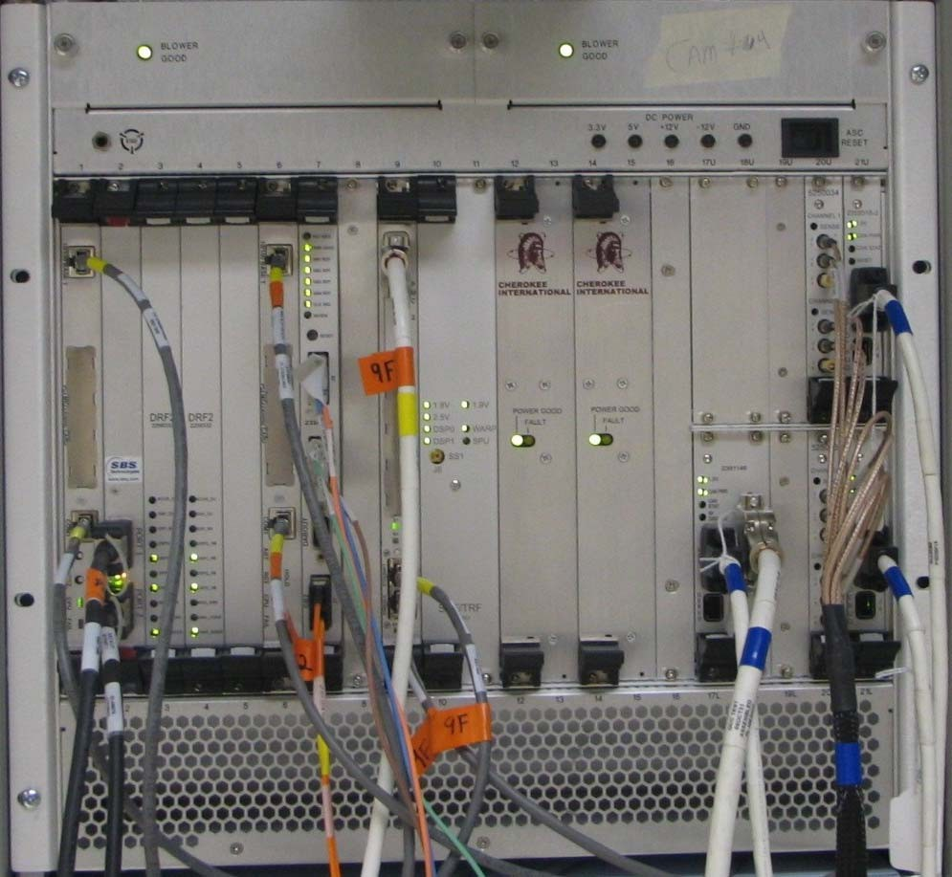
System Cabinet – CAM Chassis Differences
Rev. 1
Though the functionality didn’t change, there are some hardware differences between the MGD chassis and the CAM chassis. These include:
Blower Assembly – Different module with integrated status LED.
Power Supply – Different Vendor with integrated status LED.
Voltage test points and Status LEDs - Test points are part of chassis instead of a separate indicator module. The Chassis Power Supply LEDs were removed as actual PS values can be read from the UPM Diagnostics by selecting Analog Data. The power supplies and blower assemblies include the Status LEDs within their modules.
Bridge Board – Mounted in the front rather than the of rear of the chassis.
MGD Functionality
Power Supplies
ASC Functionality
Card Slots – New card slot locations for
boards plus additional slots added for the ASC functionality.

Slide 33
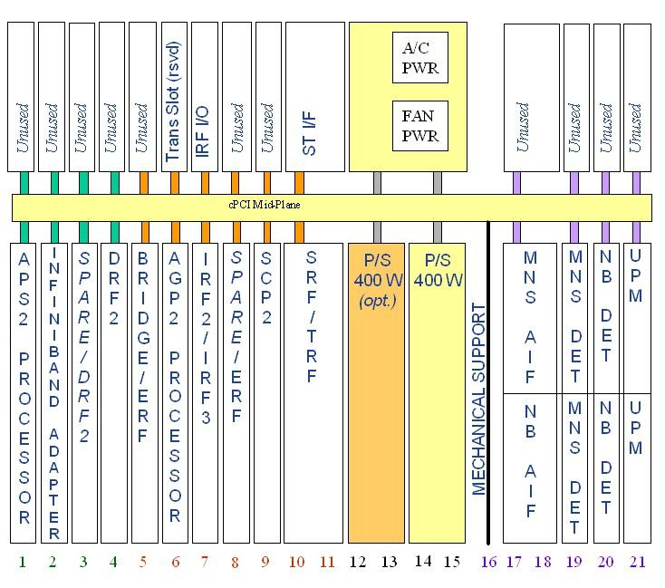
System Cabinet – CAM Chassis Slot Definitions
Rev. 1
Rear Slots:
Slot 8 : Interface and Remote I/F (IRF I/O) Slots 10-11: SRF/TRF Interface (STIF) Slots 12-15: Fan Pwr, AC Pwr, Can Comm
Front Slots:
Slot 1: APS2 Processor Board Slot 2: Infiniband Adapter Board Slot 3: DRF2 Board or Spare Slot 4: DRF2 Board
Slot 5: Bridge Board
Slot 6: AGP2 Processor Board Slot 7: IRF2 Board
Slot 8: Spare
Slot 9: SCP2 Board
Slots 10,11: SRF/TRF Board
Slots 12-13 & 14-15: Power Supply
Slots 17U-18U: Optional MNS Amp I/F Board Slots 17L-18L: Narrow Band Amp I/F Board Slot 19U: Optional MNS Detector Board
Slot 19L: Optional MNS Detector Board Slot 20U: Narrow Band Detector Board Slot 20L: Narrow Band Detector Board Slot 21U: UPM Processor Board
Slot 21L: UPM Processor Board

Slide 34
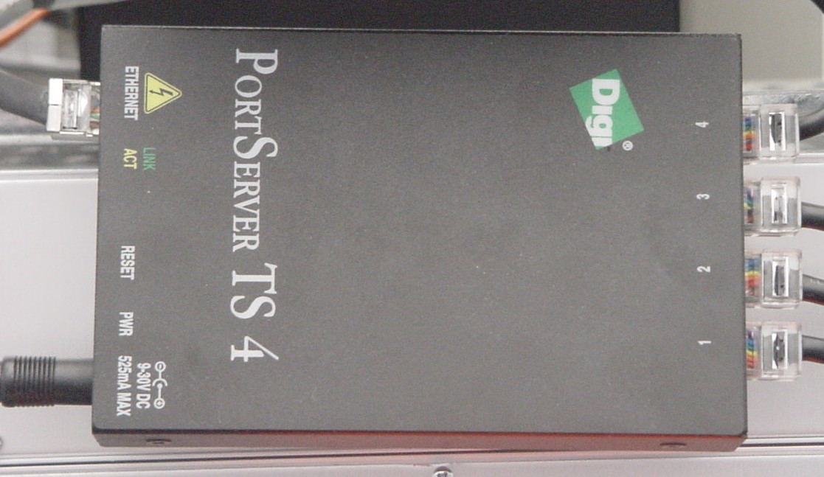
System Cabinet – Term Server
Rev. 1
The Term Server permits RS-232C serial connection to each of the processor boards and the STIF Board by utilizing the existing Ethernet link. Serial ports are selected at the Term Server based on the information received in the Ethernet signal. The serial lines on the Term Server are connected as follows: Port 1 connects to the APS, Port 2 connects to the AGP, Port 3 connects to the SCP, and Port 4 connects to the Host serial reset port on the STIF Board. With the exception of the Port 4 connection to the STIF Board, it is not necessary for any of the other serial ports to be functional in order for the system to boot or for the MGD to reset. If the Port 4 serial connection is not functioning, it may not be possible to complete a TPS Reset from the Host. The Ethernet cable from the Term Server can connect to any open port on the Ethernet Switch. The Term Server is physically located next to the Ethernet Switch.

Slide 35
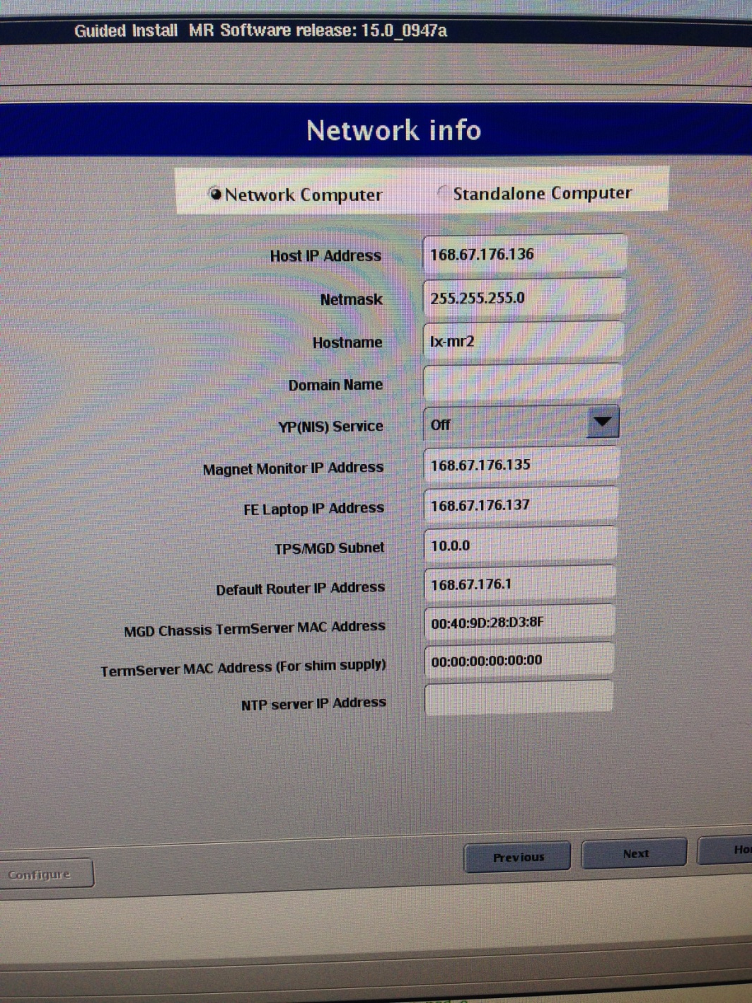
Term Server
Alternative IP Address:
10.0.x
192.168.x
10.47.x
10.121.x
10.217.x
172.22.x

Slide 36
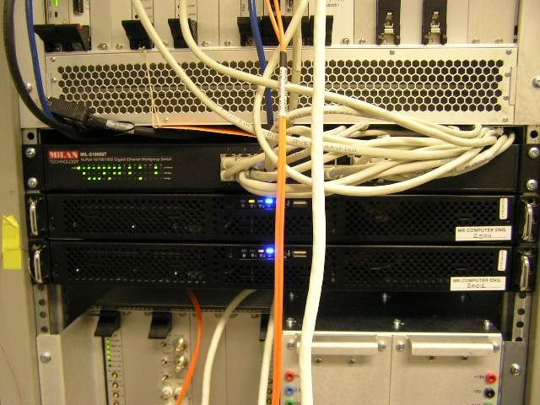
System Cabinet – Network Switch
Rev. 1
Network switch
The Network Switch is either a 16 or 24 port Gigabit Ethernet switch. The status of each port is indicated by a set of LEDs viewable on the front of the switch. The LEDs indicate link activity, and link speed. Some models also show whether the communication is full or half duplex. In normal operation, each link with a Ethernet cable connected should show Link Activity and the Power LED should be lit/active. The Ethernet lines can be connected to any of the ports in any order. Connections can be swapped between any of ports for troubleshooting.

Slide 37
System Cabinet – VRE subsystem
Rev. 1
Infiniband Board
Network switch
ICN Chassis
The VRE consists of the Infiniband Board, the Network Switch, and 2 or 4 ICN chassis

Slide 38
